Slide 1

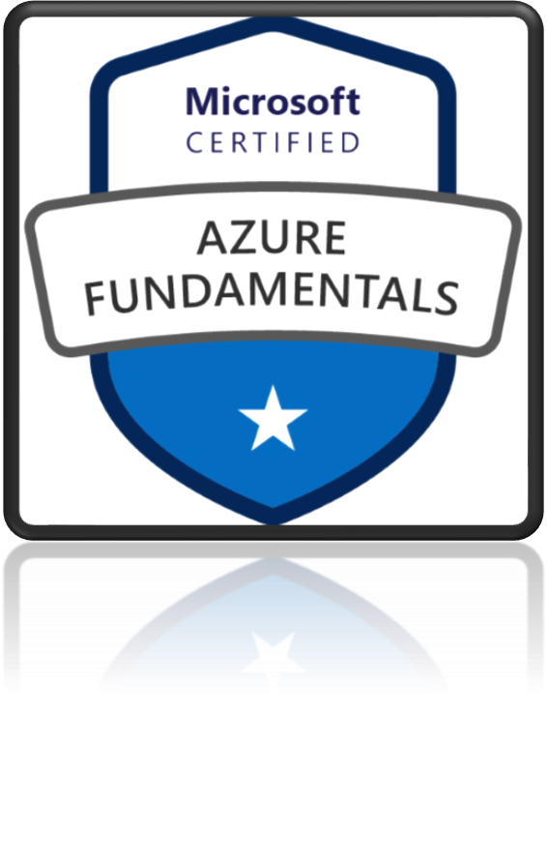
AZ-900
Microsoft Azure Fundamentals

Slide 2
What is Compute?
Azure Virtual Machine – IaaS, configure OS, CPU, RAM storage and so on
Demo: Deploy and resize VMs
Deploy Website on VM
Load Balancer
Distribute traffic to your backend virtual machines
Availability Zones
Each Availability Zone has a distinct power source, network, and cooling.
Availability sets
Fault Domains, and Update Domains.
Virtual Machines Scale Sets
Create and manage a group of load balanced VMs.
Azure App Service
Enables you to host and manage your web applications
Containers
Containers are a way to wrap up an application into its own isolated package
Azure Container Instances (ACI) vs Azure Kubernetes Services
Virtual Machine vs Containers
Azure Container Registry
Azure Virtual Desktop (Windows Virtual Desktop)
Learning Outcome

Slide 3
Azure Serverless Technologies
In this module, you'll learn about two serverless computing solutions on Azure: Azure Functions and Azure Logic Apps.
You'll learn what they are, how they differ, and when you should choose one over the other.
What is Serverless technology
Learning Objectives
Advantages of Serverless technology
Azure Functions
Azure Logic Apps

Slide 4
Serverless computing
Serverless computing is the idea that servers, infrastructure, or operating systems are behind the scene and for users they do not exist.
Infrastructure isn't your responsibility.
Scaling and performance are automatically taken care of.
Azure takes care of the servers and how resources are allocated and deallocated.
Micro-billing: Pay only for the time their code runs.
For example, if the code runs once a day for two minutes, they're charged for one execution and two minutes of computing time.
There isn't even a need to reserve capacity.

Slide 5
Serverless computing
Event-driven: Excellent fit for workloads that respond to incoming events. Events include triggers by:
Timers, for example, if a function needs to run every day at 10:00 AM UTC.
HTTP, for example, API and webhook scenarios.
Queues, for example, with order processing.
And much more.
Azure has two implementations of serverless compute:
Azure Functions: Functions can execute code in almost any modern language.
Azure Logic Apps: Logic apps are designed in a web-based designer and can execute logic triggered by Azure services without writing any code.

Slide 6

Azure Function
Azure Functions provide a serverless compute experience.

Slide 7
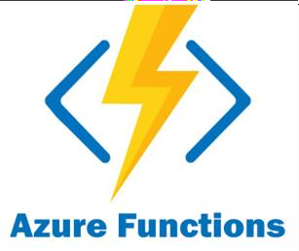
Azure Functions
It is a serverless platform
Execute your code when needed
Event-driven solution - execution of your code is triggered by a specific type of event.
Pay only for the time spent running your code.
No worry about configuration or management of the underlying physical and application infrastructure.
Azure Functions can be triggered by various event types, including HTTP requests.
Functions scale automatically based on demand
Functions can be either stateless or stateful.
Resilience: If one of your functions fails, it has no effect on other functions.
User Case:
Process file uploads - Run code when a file is uploaded or changed in blob storage
Build a web API - Implement an endpoint for your web applications using the HTTP trigger
Respond to database changes - Run custom logic when a document is created or updated in Cosmos DB

Slide 8

Logic Apps
Quickly build powerful integration solutions

Slide 9
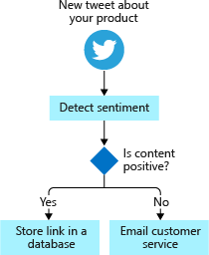
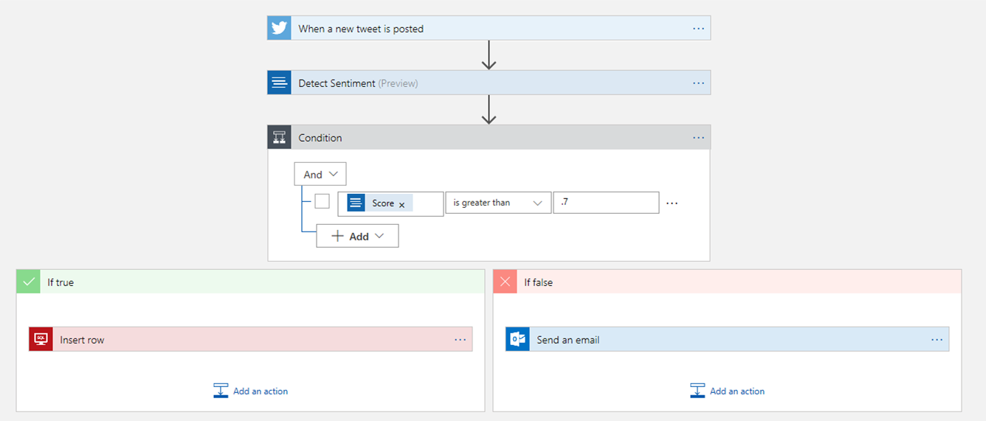
Logic Apps
Designed to automate business scenarios
logic apps execute workflows
Workflow includes actions like data conversions and flow controls, such as conditional statements, switch statements, loops,
and branching.
Design using visual designer on the Azure portal or in Visual Studio
Built from predefined logic blocks.
More than 200 different connectors and processing blocks to interact with different services.
Starts with a trigger

Slide 10
What is Serverless technology
Serverless computing is the idea that servers, infrastructure, or operating systems
are behind the scene and for users they do not exist.
Infrastructure isn't your responsibility
Advantages of Serverless technology
Learning Outcome
Scaling and performance are automatically taken care of
Micro-billing: Pay only for the time their code runs.
There isn't even a need to reserve capacity.
Event-driven
Azure Functions
Execute your code when needed
Azure Logic Apps
Designed to automate business scenarios

Slide 11
Azure networking services
In this module, you'll learn about the different Azure networking options and the scenarios in which each is appropriate.
Virtual Network (VNet) and Subnets
VPN Gateway and Vnet Peering
Load Balancer and Application Gateway
Learning Objectives
Content Delivery Network (CDN)
ExpressRoute
ExpressRoute vs VPN Gateway
Azure DNS
Public and Private Endpoints

